Slide 1
Data Analytics /w Python Homework 1
Sentiment Analysis on Twitter (X) Setup

Slide 2
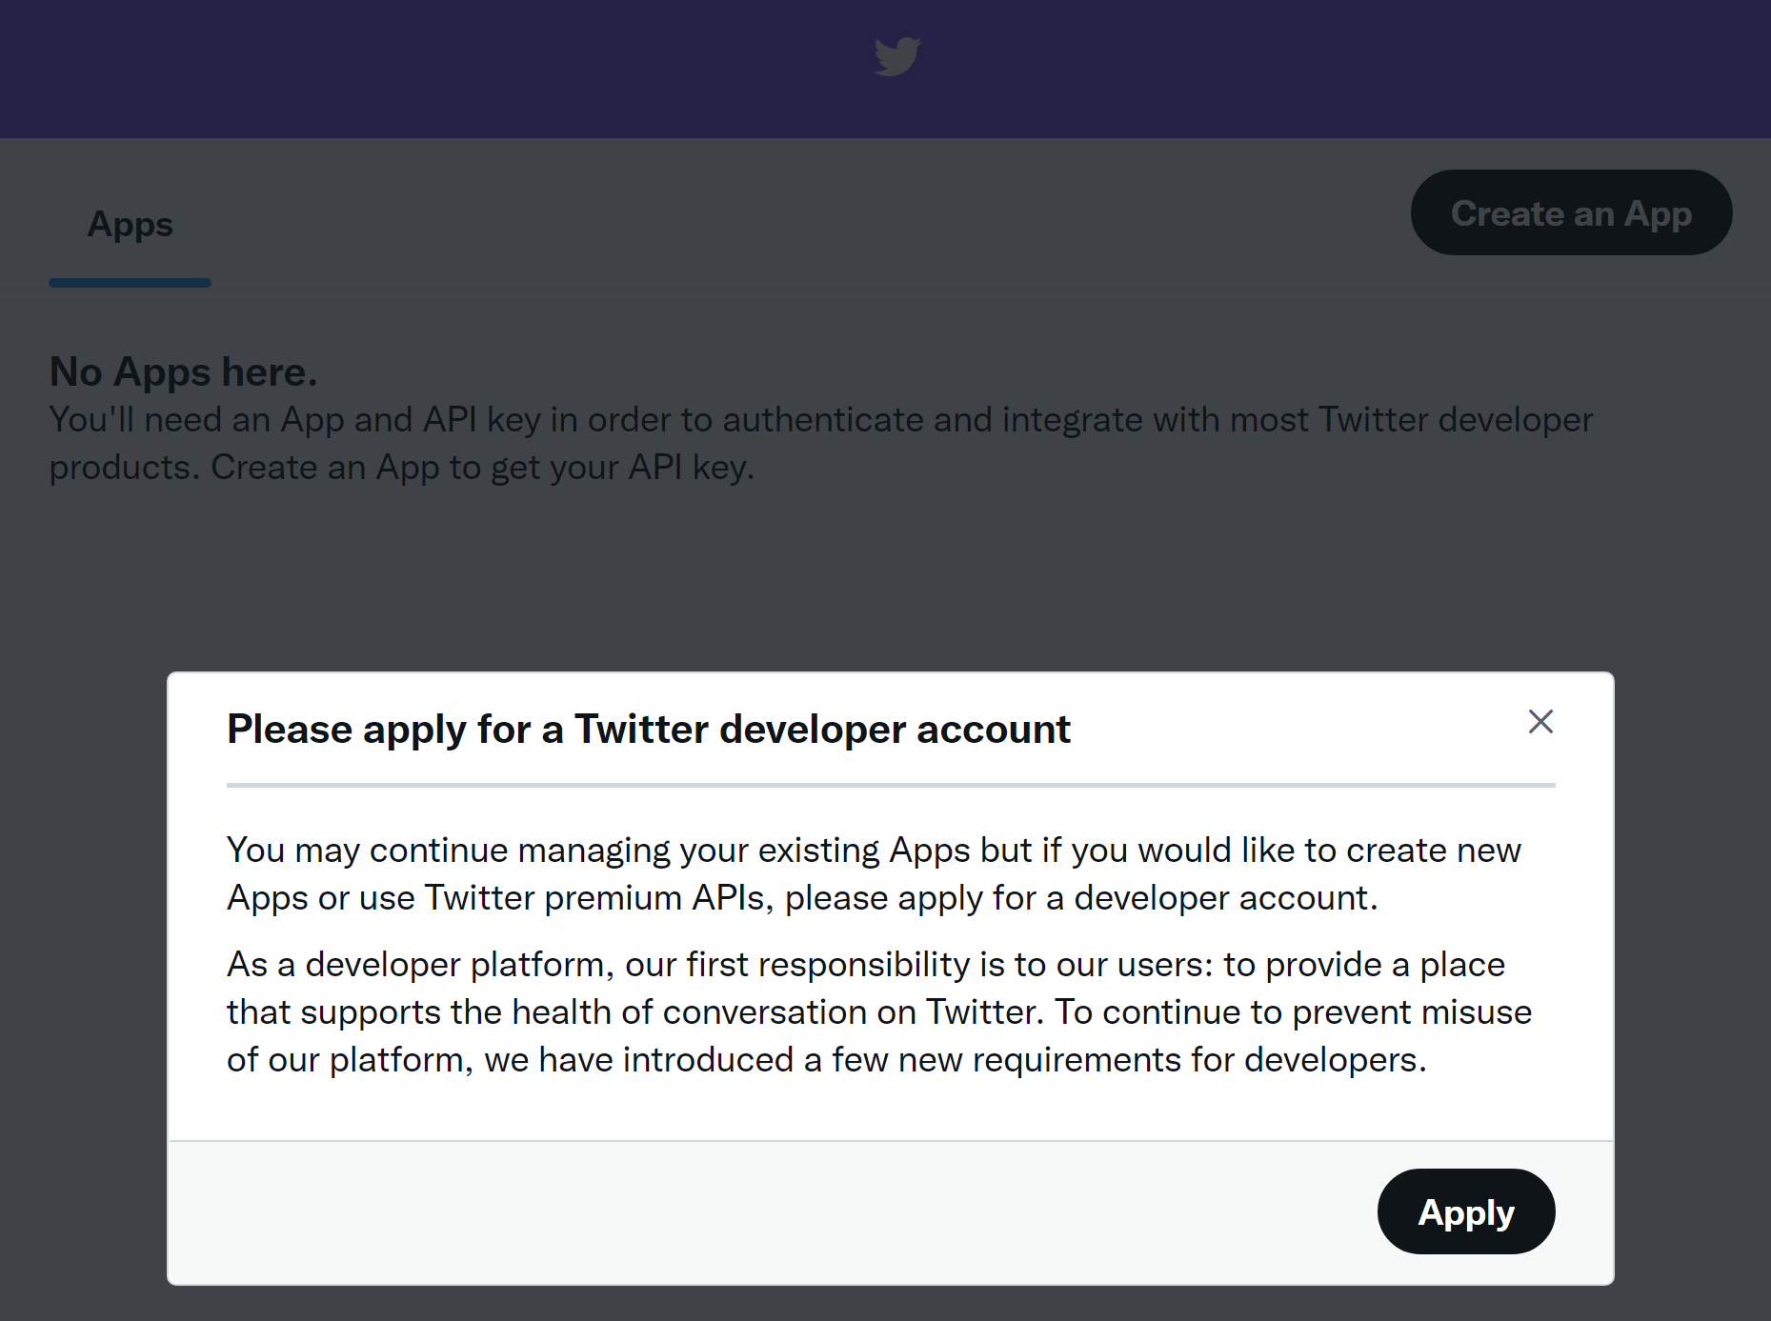
Apply for a Twitter Developer Account
To be able to use the Twitter APIs, you will need to register as a Twitter app developer:
Log onto Twitter, and then go to the developer page: https://developer.twitter.com/en/apps
Click on “Add Project”
Apply for a Twitter Developer Account (fill out form)

Slide 3
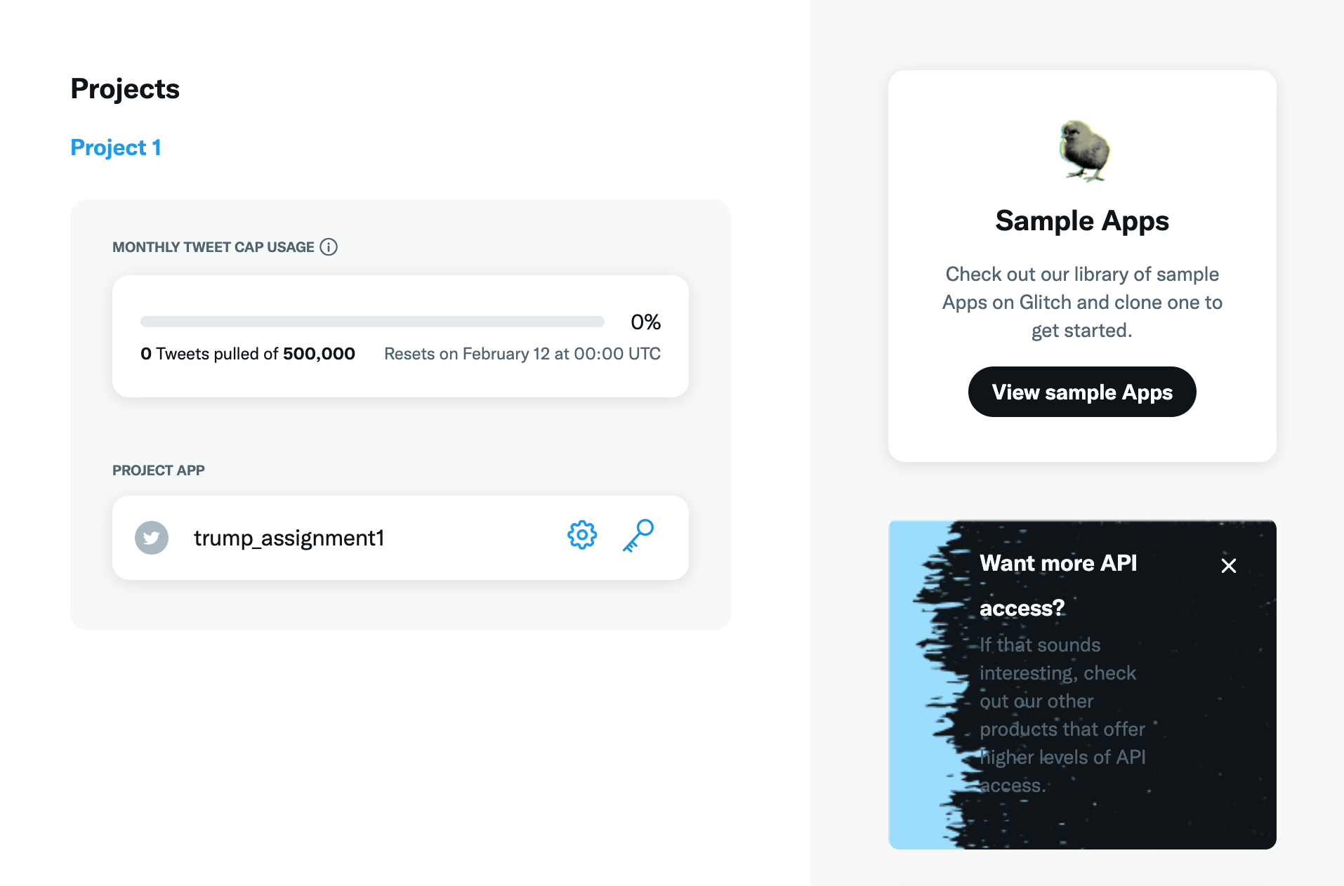
Apply for Elevated Access Levels
Response for “In your words”:
I am using the Twitter API/Twitter data as part of a homework assignment that is part of my Data Science with Python course. Twitter API/data helps us learn how to collect, clean, and analyze data with Python.
Response on “The Specifics” (respond no to other questions):
Are you planning to analyze Twitter data? Yes, we are understanding whether there is a positive, negative, or other sentiment pertaining to a certain topic.
Click towards the bottom of this box!

Slide 4
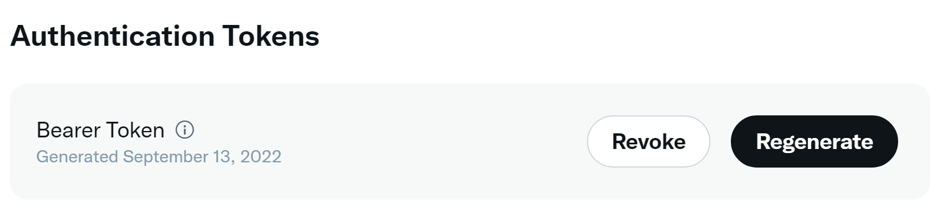
Prepare tweetering.py with your Bearer Token
Download tweetering.py from Camino
Click on your app name on Twitter Developer
Click on “Keys and Access Tokens”
Identify your Bearer Token under “Authentication Tokens”
Copy your Bearer Token into tweetering.py on line 28, as instructed by the comment

Slide 5

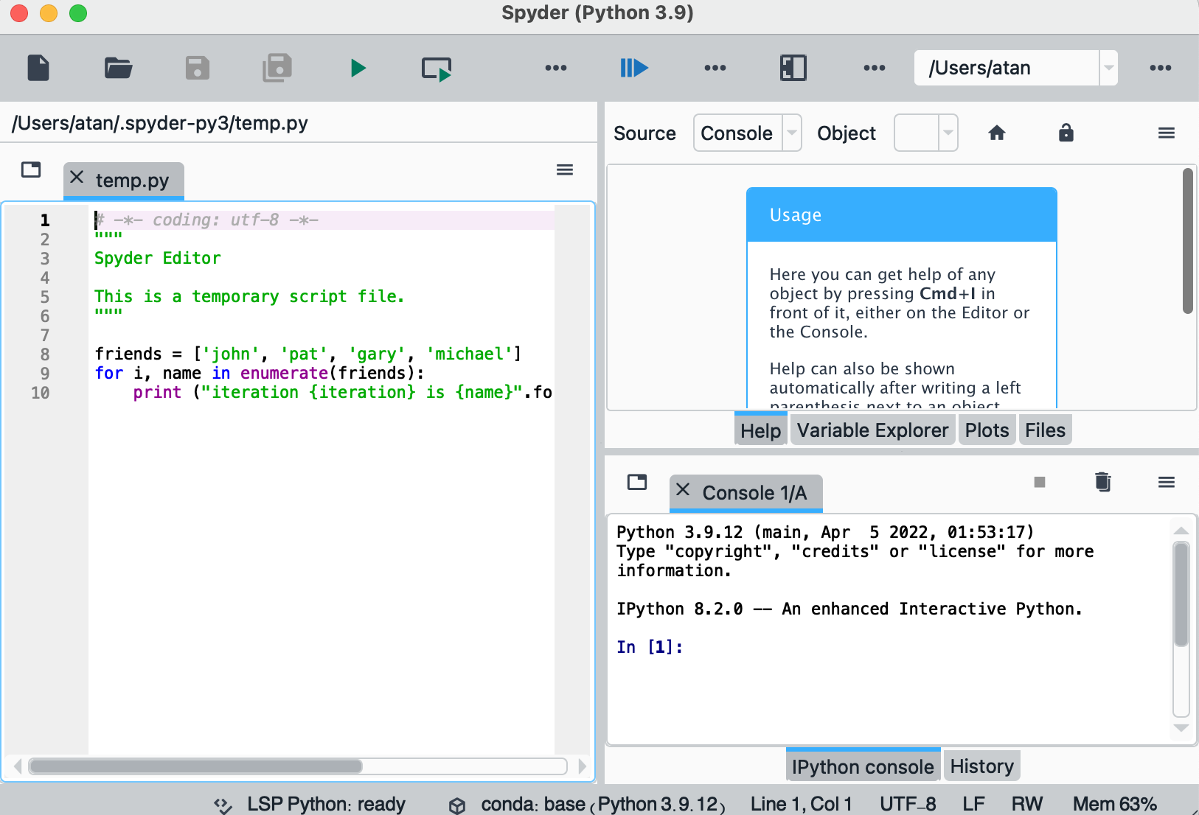
In Anaconda Navigator, launch Spyder In Editor window, open tweetering.py

Slide 6
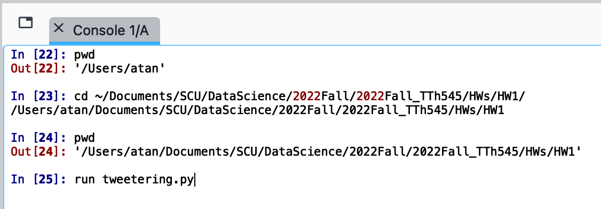
In Spyder IDE, Console window, issue commands
1. Change directory to the one containing your twitter files
2. To run the program, type:
run tweetering.py word
Where word is the term you want
to look for (here the word is “Trump”)
3. The program creates an output file
(word.txt) with the tweets collected
4. Stop collecting tweets by pressing
CTRL + c
Note: output file will be overwritten if
same file name exist in the same directory

Slide 7
Possible Problems
Tweepy not found: (refer to page #39, Module 1 – Intro and Python Review ppt file.
Open a terminal
In terminal, type
conda install -c conda-forge tweepy

